Slide 1
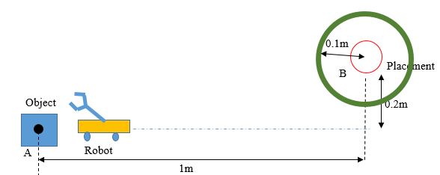
Project Design
An autonomous Robot for Cargo Handling
Two Phases
Phase 1: moving from the start point to the around area of the designated region (a circle of radius of 0.1m, line C), and ceasing its motion
Phase 2: design and install a robotic arm with a simple gripper for the robot. The robot need to pick and convey a cylindrical object from the start point to the designated region, and place the object into a round box at region B
0.05m
C
No human intervention is allowed after the motion is initiated
Violators will have 50% points deduction
Notes:
The students will design and build a strong, light-weight automatic guided mobile robot using any materials and tools such as printing papers, plastic plates, DC motors, gearboxes, transmission belts, sensors, and a programmable micro controller unit (MCU), and etc. No human intervention is allowed after the motion is initiated

Slide 2
Project Design
An autonomous Robot for Cargo Handling
Important sizes
platform A: height: 80mm;
cylindrical object: radius: 10mm; height: 40mm;
green/black band: width: 30mm, radius of inner circle: 100mm;
round box at B: radius: 50mm; height: 50mm
0.05m
C
Notes:
The students will design and build a strong, light-weight automatic guided mobile robot using any materials and tools such as printing papers, plastic plates, DC motors, gearboxes, transmission belts, sensors, and a programmable micro controller unit (MCU), and etc. No human intervention is allowed after the motion is initiated

Slide 3
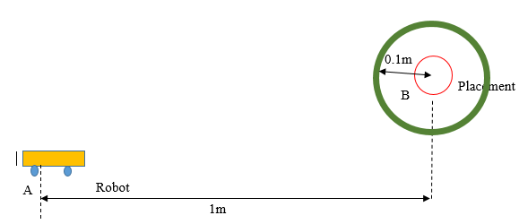
Project Design
An autonomous Robot for Cargo Handling
Phase 1: moving from the start point to the around area of the designated region (a circle of radius of 0.1m), and ceasing its motion
Encourage innovation, open mind, and challenging difficult approach (bonus 1-5 points)
0.05m
C
No human intervention is allowed after the motion is initiated
Violators will have 50% points deduction

Slide 4
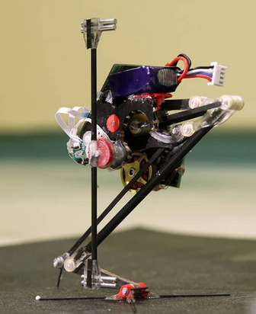
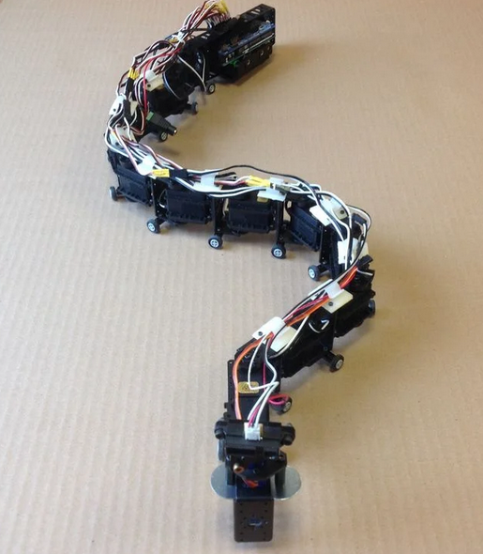
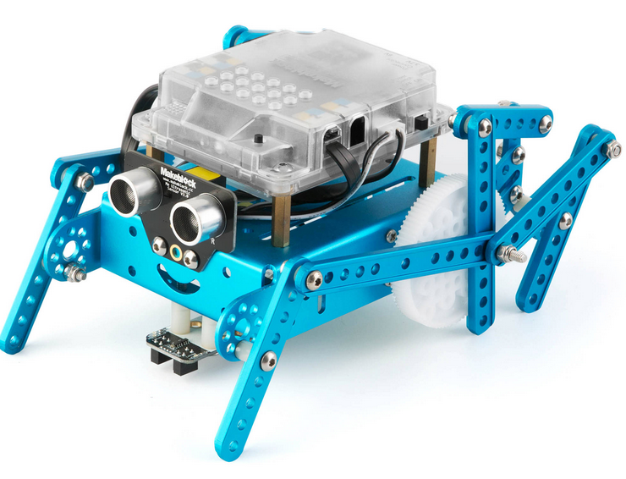
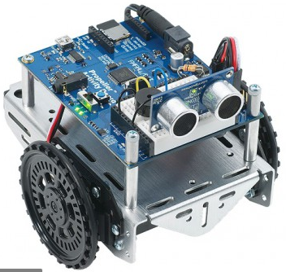
Project Design
Smart Robot for Cargo Handling
Phase 1: moving from the start point to the around area of the designated point (a circle of radius of 0.1m), and ceasing its motion
Different approaches from A to B
0.05m

Slide 5
Project Design
Smart Robot for Cargo Handling
Phase 2: Deliver object from A to B
0.05m
Execute pick and place task
Encourage innovation, open mind, and challenging difficult approach (bonus 1-5 points)

Slide 6
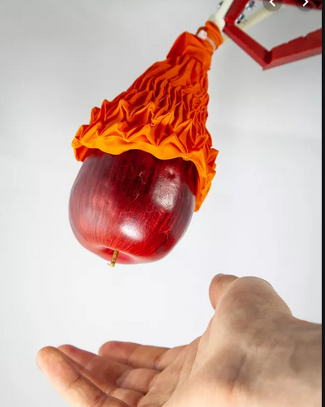
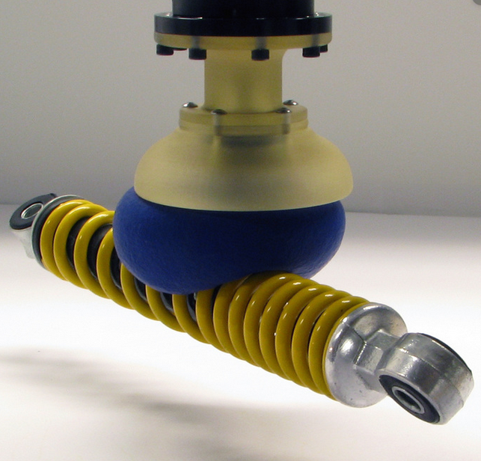
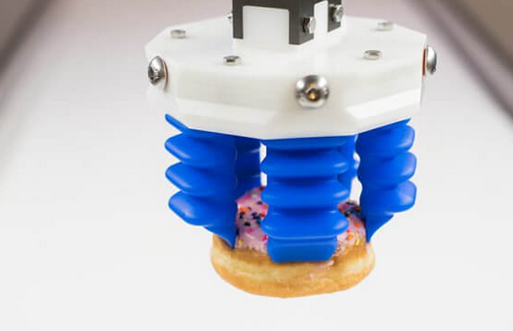
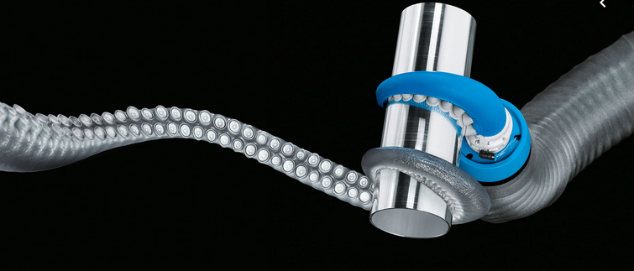
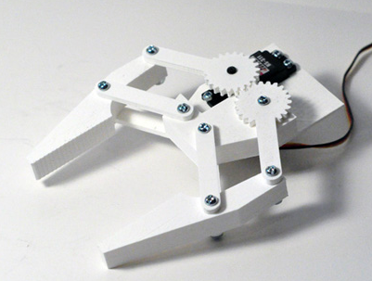
Project Design
Smart Robot for Cargo Handling
Phase 2: Deliver object from A to B
0.05m
Execute pick and place task

Slide 7
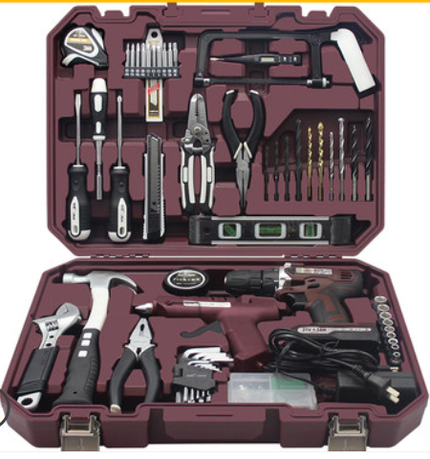
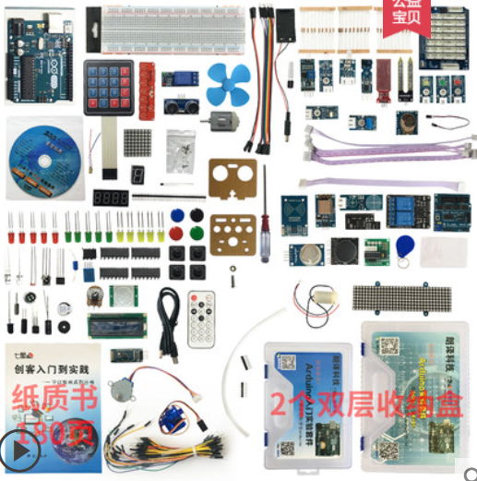
Project Design
Tools prepared for the project
Hardware tools box, Arduino package, sensors, motors, etc.

Slide 8
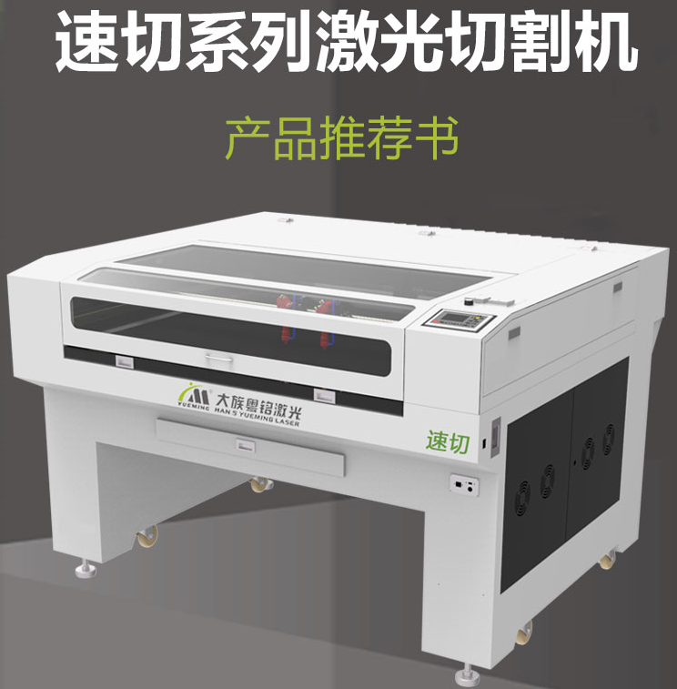
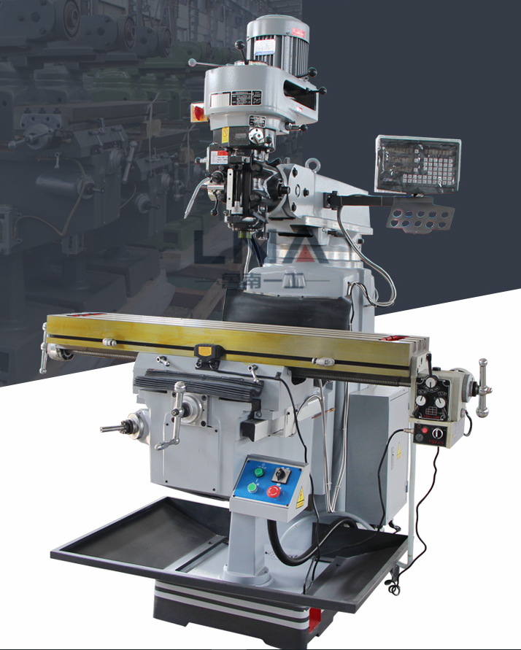
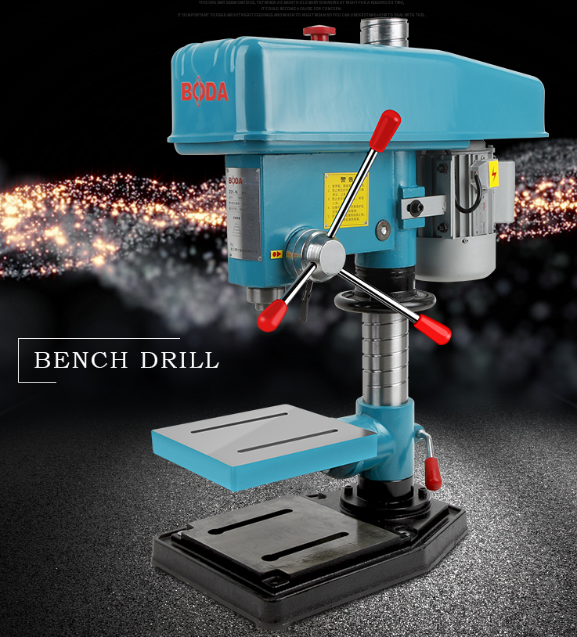
Project Design
Fabrication machines

Slide 9
Project Design
System Requirements (Rules for Inspection before Competition)
Mechanism: Any method that can achieve the above task with the system specifications mentioned here will be acceptable. Breaking any of these rules will result in failing this project.
Robot length (without the robotic arm): <= 200 mm
Robot width (without the robotic arm): <= 150 mm
Major Material: printing paper (80g size A4) and non-toxic, white wood glue (brand: LongMa “龙马“), plastic plates. Any additional material violates the rule!
Connections and transmissions: metal or plastic joints are allowed for connections and transmission mechanisms. Purchased transmission mechanisms are allowed.

Slide 10
Project Design
System Requirements (Rules for Inspection before Competition)
Power Supply: Maximum of two portable Power Supplies (for each battery: Voltage ≤ 12V)
Motor specifications: < 12V. The number and size of motors are not constrained.
Central Control Circuit: Arduino series (Required for Programming)
Logo: put your team logo on the robot car as a ruler for phase1 to rate your grades, the logo itself can be any shape but it must be restricted in a 25×25mm square, and the square is the real ruler.
If any of the above mentioned requirements are violated, the robot will be disqualified and the score of project phase 1 will be 0.

